Slide 1
SALES AND CUSTOMER INSIGHTS REPORT
RETENTION & REVENUE ANALYSIS

Slide 2
Problem Statement
Despite steady customer activity, the company lacks visibility into what drives customer retention, which segments are most valuable, and how behavior varies across time and region.
Without these insights, retention efforts risk being generic, poorly timed, and inefficient, leading to missed revenue opportunities and rising churn.

Slide 3
Objectives
Identify key drivers of customer lifetime value (LTV)
Evaluate churn and retention performance
Analyze purchase behavior across time, regions and categories
Recommend actions to improve retention and campaign performance

Slide 4
Key Insights at a Glance
Total LTV across all customers: $50.32M
Retention Rate: 49.84%, Churn Probability: 50.16%
Europe leads in LTV; Asia has the highest churn
October & Summer are peak sales periods
Most retention strategies fall into “Needs Improvement” or “At Risk”

Slide 5
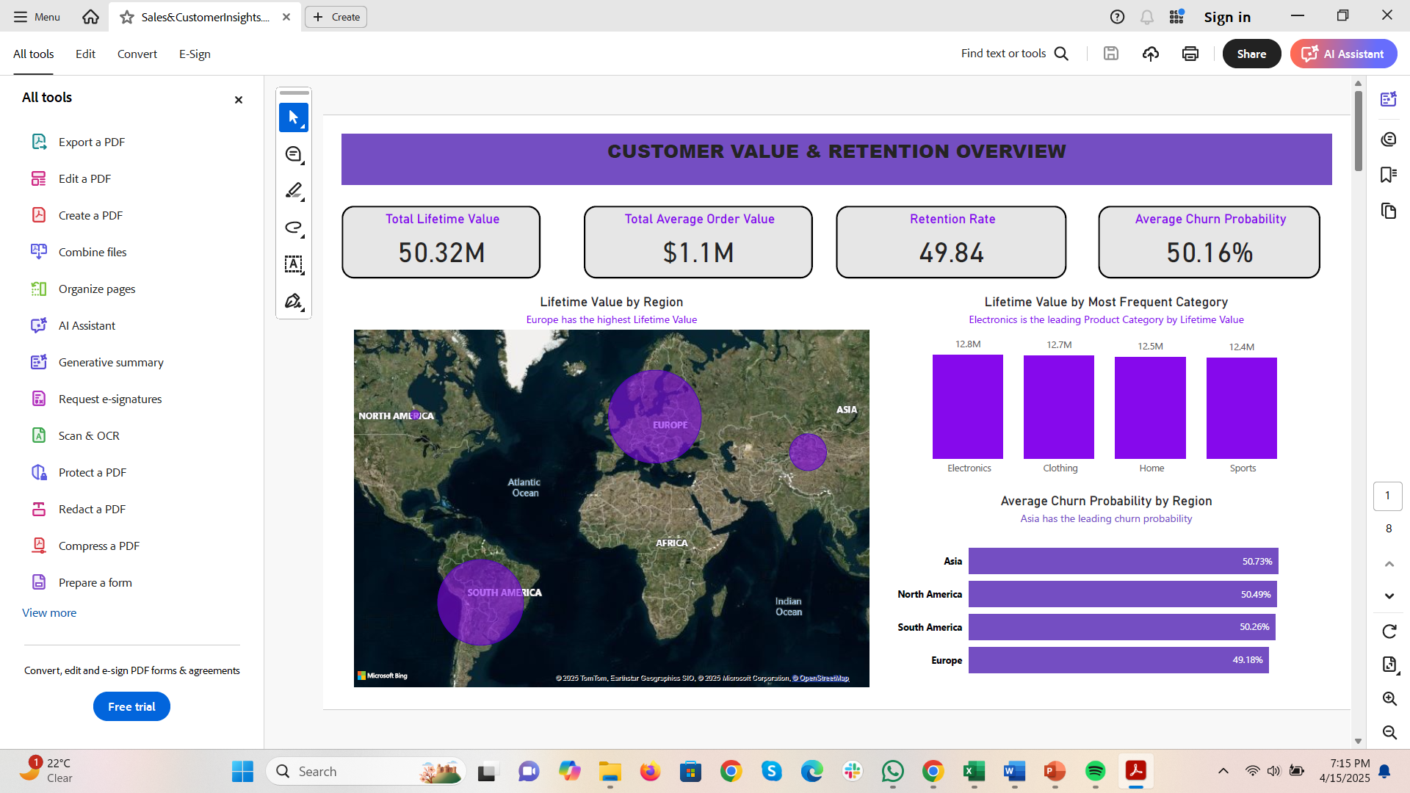
Lifetime Value(LTV) by Region & Category
-Electronics and Clothing lead in LTV
-Europe contributes the highest regional LTV

Slide 6
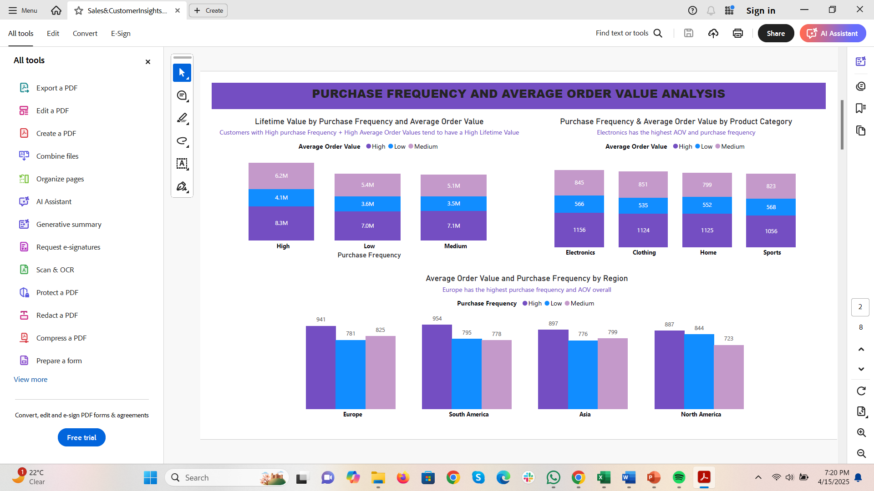
Purchase & AOV impact on LTV
-Customers with high purchase frequency + high AOV are the most valuable
-Electronics dominates across both metrics

Slide 7
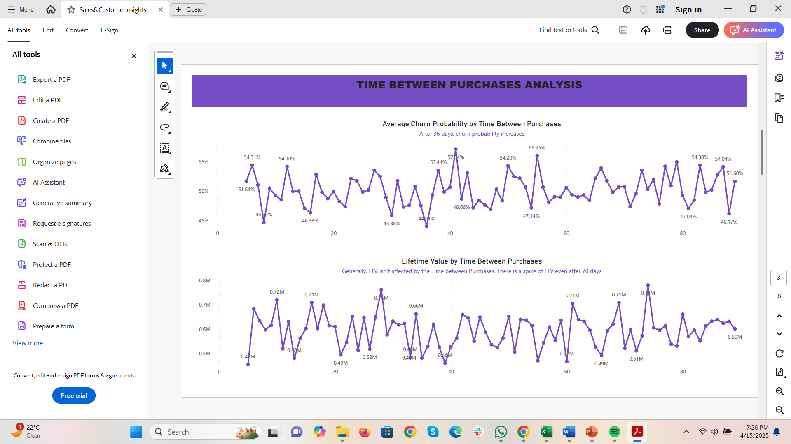
Time between Purchases and Churn
-Churn Probability spikes after 36 days
-Some high LTV customers shop less frequently- consider nurture campaigns over churn focused efforts

Slide 8
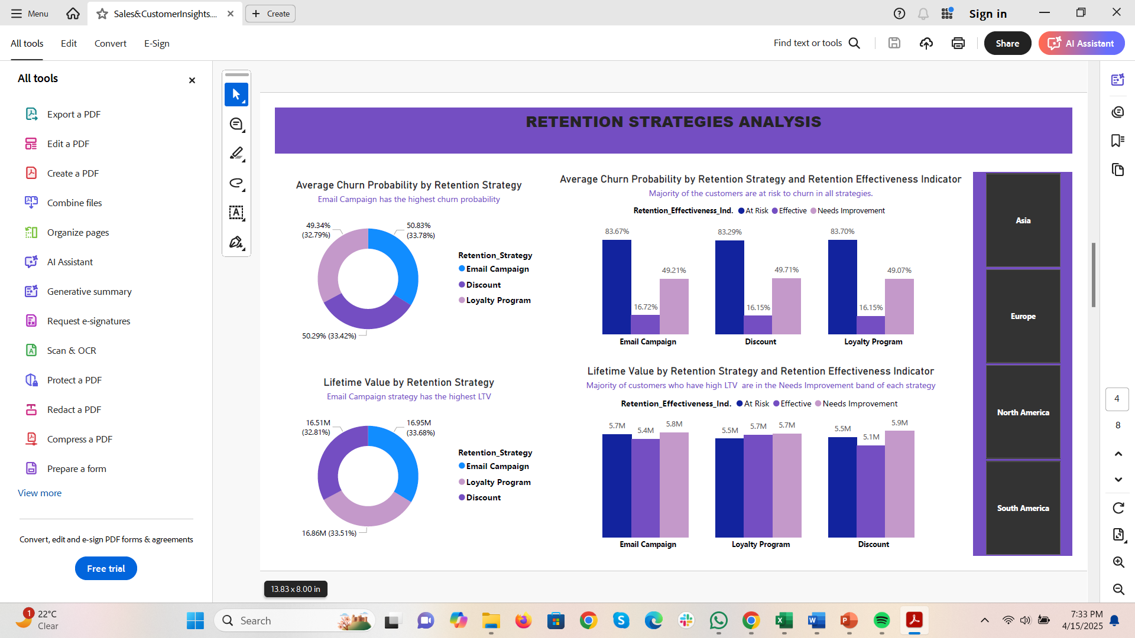
Retention Strategy Performance
-Email campaigns drive high LTV but also highest churn
-Most customers fall under “Needs Improvement” retention effectiveness
-Loyalty Programs have lower churn but lower value

Slide 9
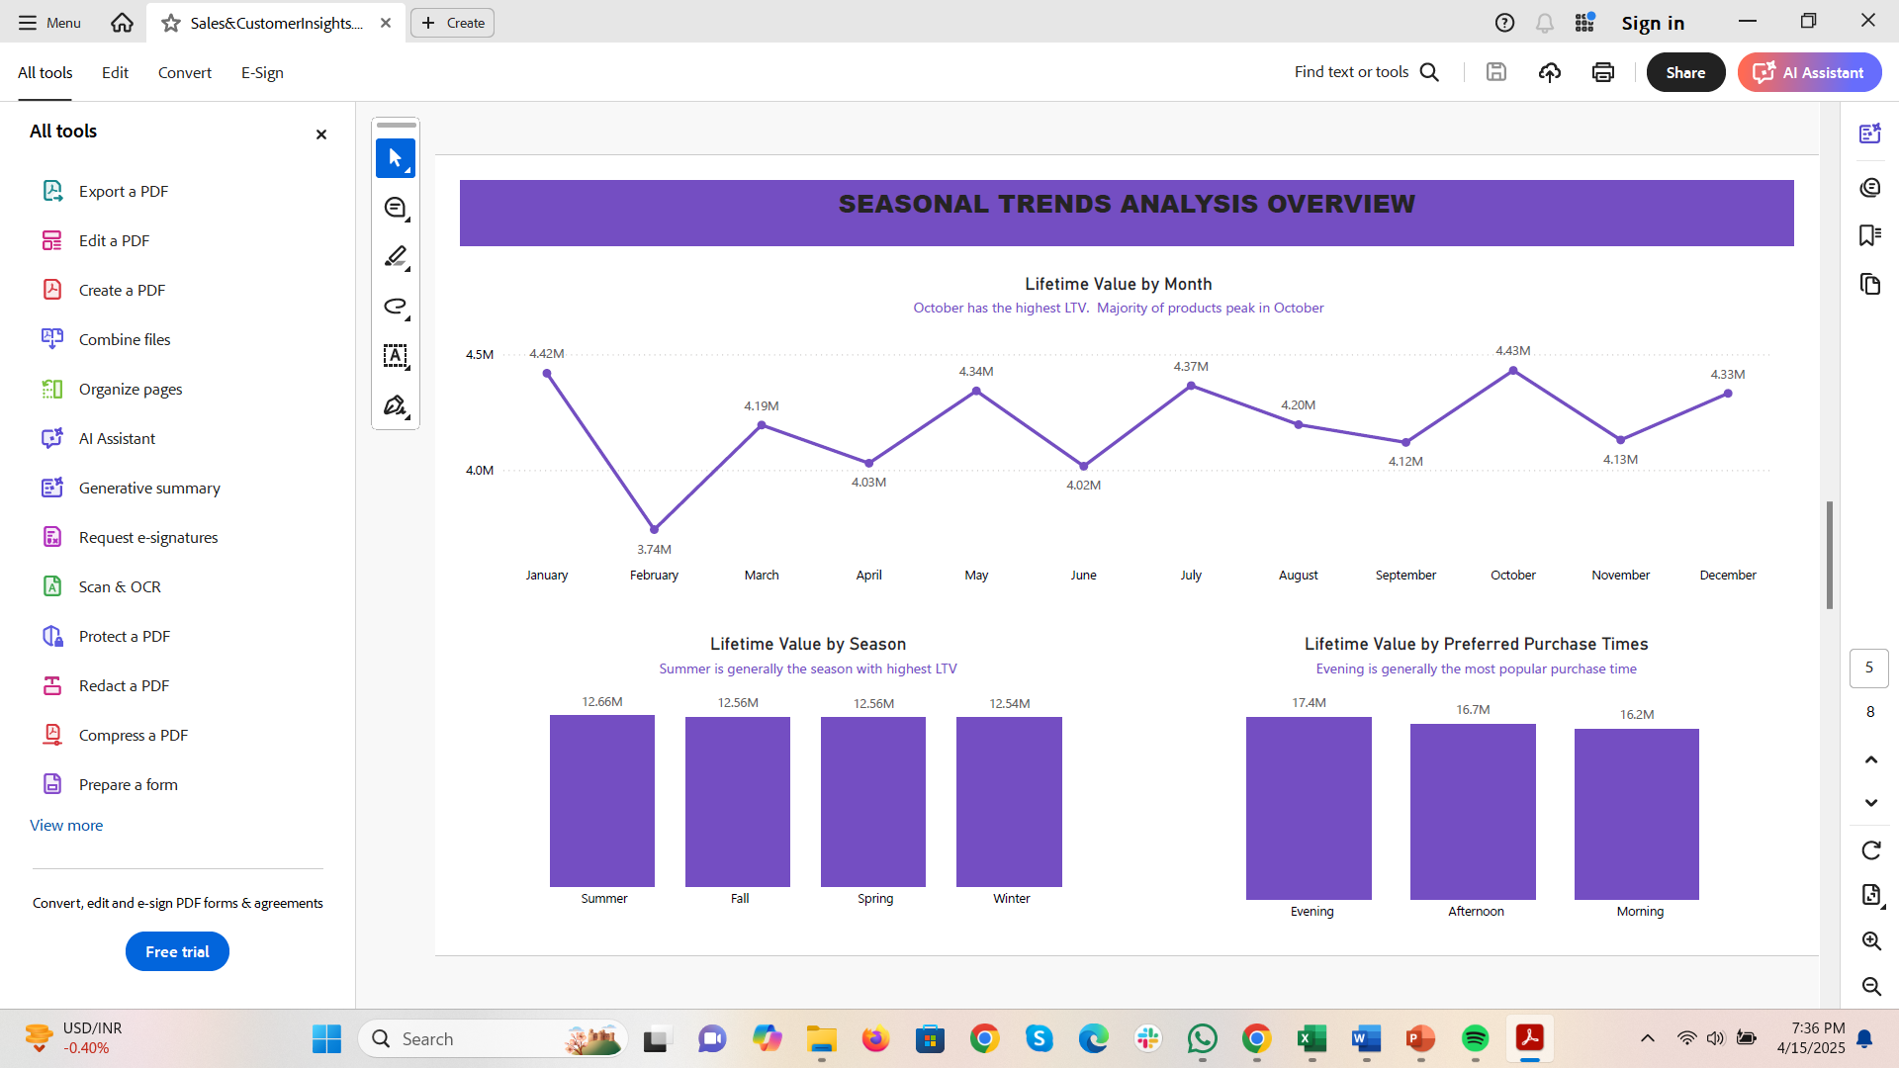
When Customers Buy
-October and Summer show the highest LTV
-Evening is the most common purchase time
-Time-of-day and season preferences vary by product and region

Slide 10
Strategic Recommendations
Refine email campaigns to reduce churn while maintaining LTV
Invest in loyalty and discount strategies to strengthen retention
Retention Strategy recommendations:
-Implement nurture campaigns (e.g., personalized updates, exclusive content) to engage high-value but infrequent buyers
-Deploy churn-focused interventions (e.g., win-back offers, exit surveys) for at-risk customers with high churn probability
Launch promotions in Summer and October
Tailor campaigns by Region + Product + Season + Purchase Time
Target customers with 36+ day purchase gaps using engagement triggers

Slide 11
THANK YOU!
Questions or Feedback?

